Slide 1
Chapter No 12
BEE-12 A, B & C
Dec-2022

Slide 2
General Information on op-amp 741
Introduction

Slide 3
Chapter No 12 sub-sections
MOSFET Operational amplifier
BJT 741 Operational amplifier
Identifying subsection of 741
DC /Biasing analysis
Small signal analysis
Modern techniques for design of BJT Operational amplifier

Slide 4
Introduction
The 741 Op Amp IC is most commonly used general purpose Operational Amplifier.
It was first manufactured by Fairchild semiconductors in the year 1963.
It performs both mathematical operations and amplification functions (mathematical operations like addition, subtraction, multiplication, division, differentiation, integration, etc.)

Slide 9
8 Pin DIP Package 2. TO5-8 Metal can package 3. 8 Pin SOIC

Slide 10
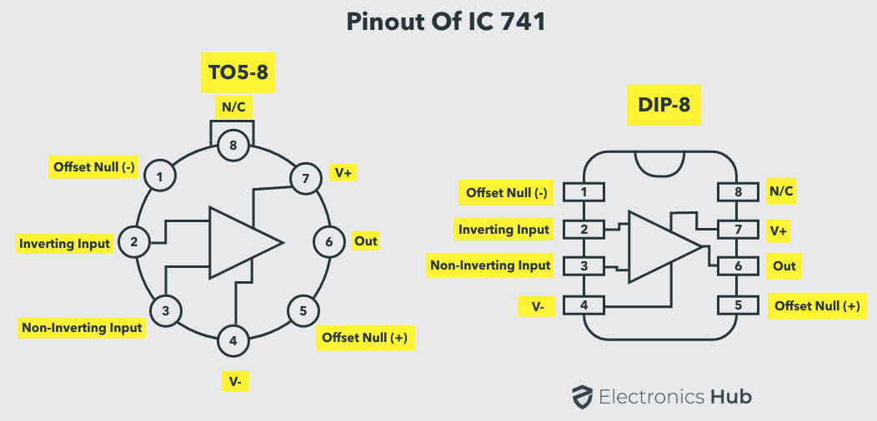

Slide 13
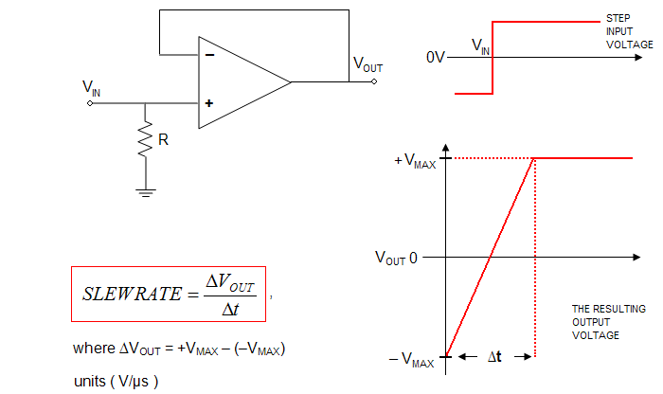

Slide 14
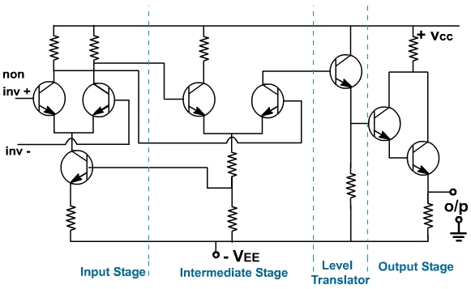
Conceptual Circuit Diagram of BJT Op-amp

Slide 15
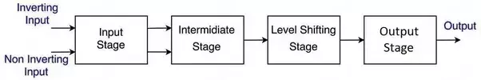
The input stage is a dual point, balanced output differential amplifier. This stage generally provides most of voltage gain of amplifier and also establishes the input resistance of op-amp. The intermediate stage is usually another differential amplifier , which is driven by output of first stage . In most amplifiers, the intermediate stage is dual input, unbalanced(single-ended) output. Because direct coupling is used, the DC voltage at the output of intermediate stage is well above ground potential. Therefore , generally a level translator(shifting) circuit(usually Emitter Follower) is used after intermediate stage to shift the DC level to zero volts with respect to ground.

Slide 16
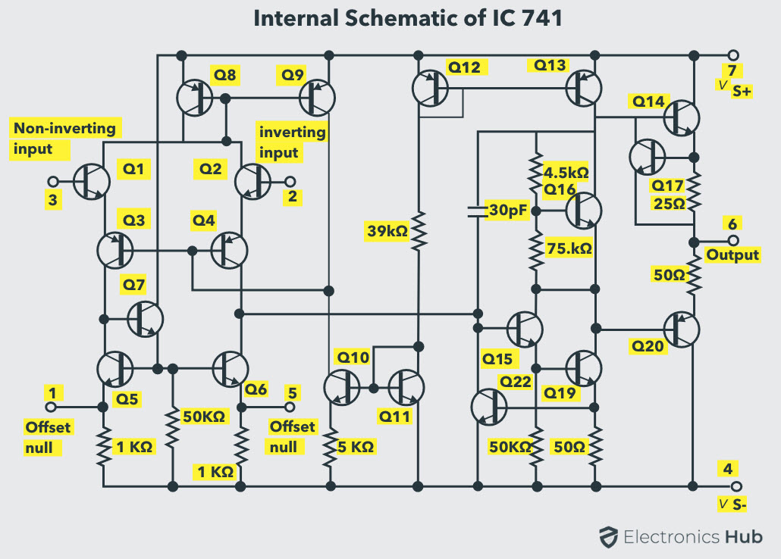

Slide 18
Part-I Recognizing / Identifying various sub-sections of 741

Slide 19
$V_{BE}$ for $Q_{14} and Q_{20}$
Current Mirror
Current Mirror
Reference
DC Biasing /Current Mirror
Widlar Current Mirror

Slide 21
Input Stage

Slide 22
Input stage
Base current compensated Load

Slide 24
Differential to single ended

Slide 25
Intermediate Stage

Slide 26
Second Stage

Slide 29
Output Stage

Slide 33
Short Circuit Protection

Slide 34
Short circuit protection
Short circuit protection

Slide 35
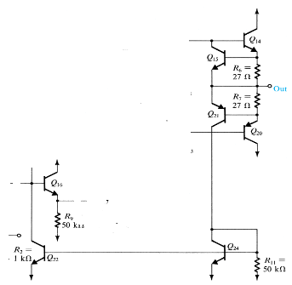

Slide 36
Part-II DC BIASING

Slide 38
Mirror-2
Mirror-1
Widlar current source

Slide 39
: Introduction

Slide 40
: Introduction

Slide 41
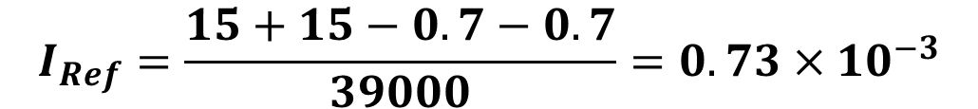

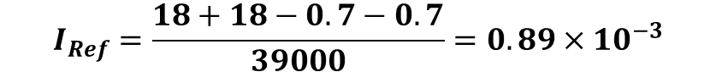
$$I_{Ref}=\frac{15+15−0.7−0.7}{39000}=0.73×{10}^{−3}$$
$$I_{Ref}=\frac{18+18−0.7−0.7}{39000}=0.89×{10}^{−3}$$
$$I_{Ref}=\frac{5+5−0.7−0.7}{39000}=0.22×{10}^{−3}$$

Slide 44
Recall from Chap. 7

Slide 45
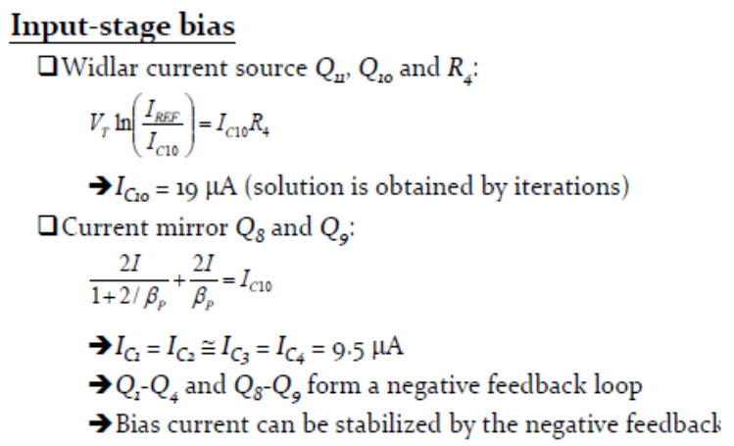
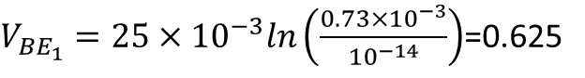
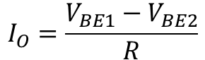
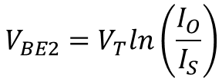
$$I_{REF}=0.73×{10}^{−3} and R_{4}=5KΩ, Assume V_{T}=25×{10}^{−3}$$
$V_{{BE}_{1}}=25×{10}^{−3}ln\left(\frac{0.73×{10}^{−3}}{{10}^{−14}}\right)$=0.625
Assuming $I_{O}$ ten time less we started the iterations
$$V_{BE2}=V_{T}ln\left(\frac{I_{O}}{I_{S}}\right)$$
$$I_{O}=\frac{V_{BE1}−V_{BE2}}{R}$$

Slide 46
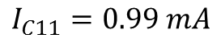
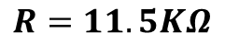
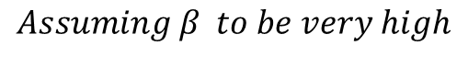
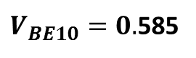
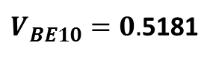
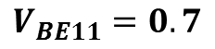
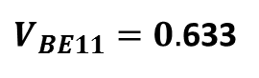
$$Assuming β to be very high$$
$$R=11.5KΩ$$
$$V_{BE11}=0.7$$
$V_{BE10}=0.$585
$$Assuming β=200;as for npn of 741$$
$$I_{C11}=0.99 mA$$
$V_{BE11}=0.$633
$V_{BE10}=0.$5181

Slide 47
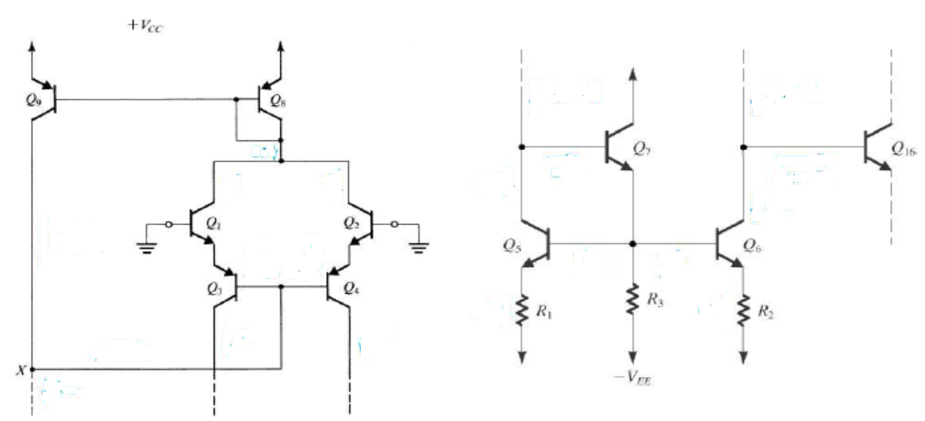

Slide 48
Break

Slide 50
Second Stage Biasing

Slide 51
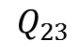
$$Q_{23}$$

Slide 53
Biasing Output Stage

Slide 57
Summary : DC currents

Slide 58
Small Signal Analysis

Slide 59
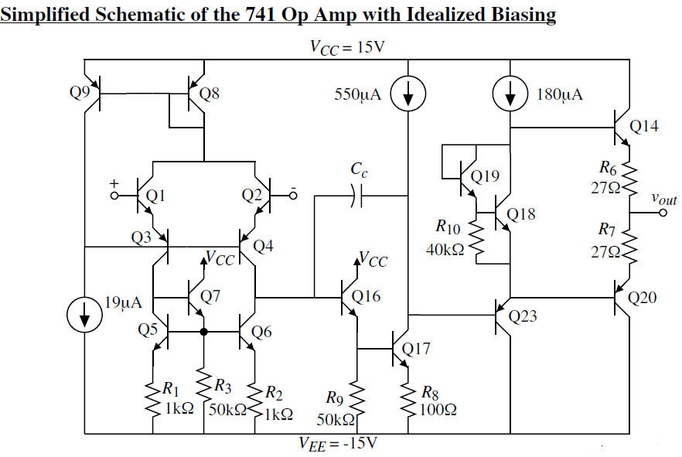

Slide 63
Small Signal Analysis

Slide 66
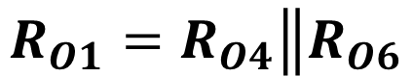
$$R_{O1}=R_{O4}\left\|R_{O6}\right.$$

Slide 67
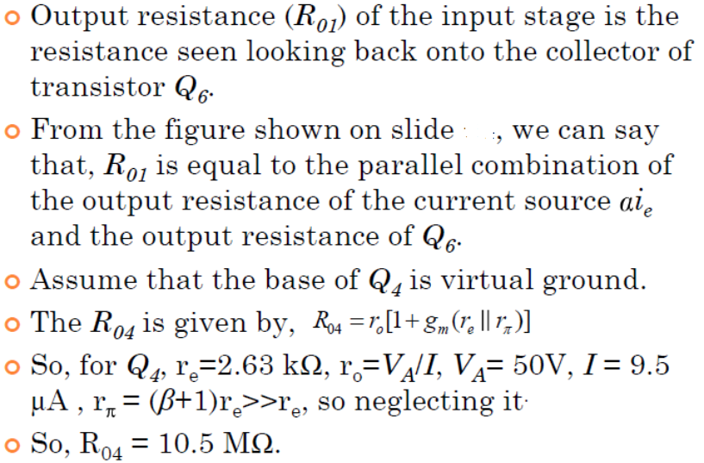
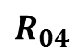
$$R_{04}$$

Slide 68
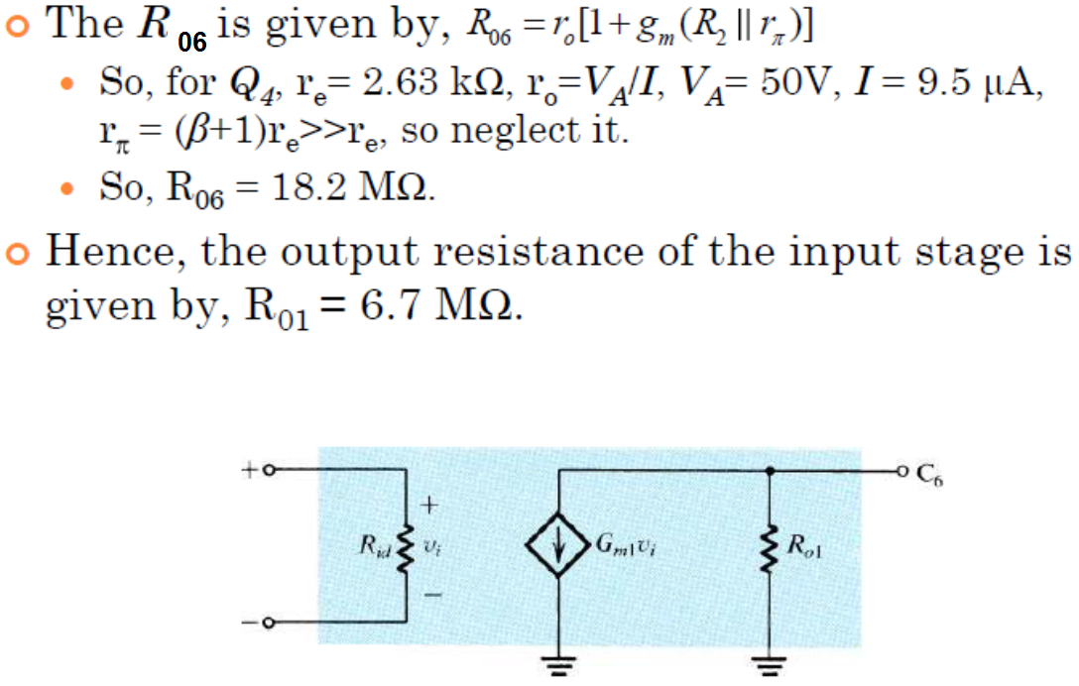

Slide 69
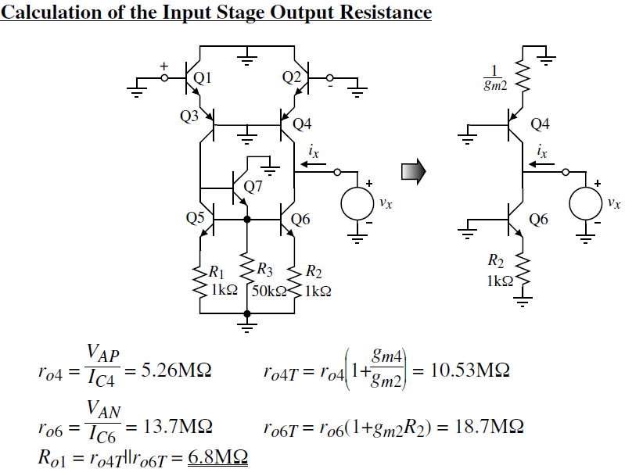

Slide 71
Summary of small signal analysis of first stage

Slide 72
Second Stage

Slide 76
Summary of small signal analysis of second stage

Slide 77
Output Stage

Slide 79
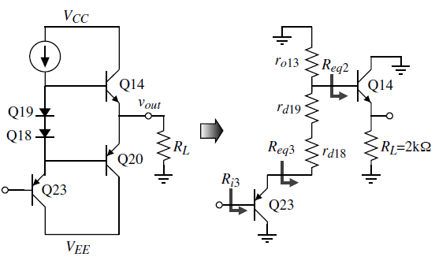
Simplified : Output stage

Slide 83
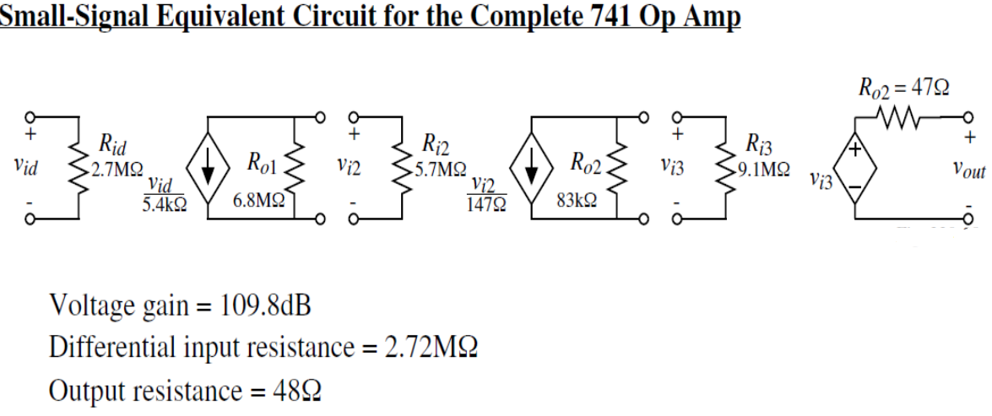

Slide 84
Output Resistance

Slide 86
Modern Techniques for the Design of BJT Op. Amps
Although the ingenious techniques employed in the design of the 741 op amp have stood the test of time, they are now more than 50 years old!
Technological advances have resulted in changes in the user requirements of general-purpose bipolar op amps. The resulting more demanding specifications have in turn posed new challenges to analog IC designers who, are responding with new and exciting circuits. In this section
we present a sample of recently developed design techniques.

Slide 87
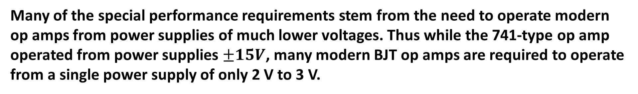
Special Performance Requirements
Many of the special performance requirements stem from the need to operate modern op amps from power supplies of much lower voltages. Thus while the 741-type op amp operated from power supplies $±15V$, many modern BJT op amps are required to operate from a single power supply of only 2 V to 3 V.

Slide 88
Many modern BJT op amps are required to operate from a single power supply of only 2 V to 3 V. This is done for a number of reasons, including the following.
1. Modern small-feature-size IC fabrication technologies require low power-supply voltages.
2. Compatibility must be achieved with other parts of the system that use low-voltage supplies.
3. Power dissipation must be minimized, especially for battery-operated equipment.

Slide 89
There are two important changes:
the use of a single ground-referenced power supply ,
and the low value of power supply.
Both of these requirements give rise to changes in performance specifications and pose new design challenges.
In the following we discuss two of the resulting changes.

Slide 90
Operational amplifiers that use the complete span between negative and positive supply voltage for signal conditioning are generally known as rail-to-rail amplifiers.

Slide 91
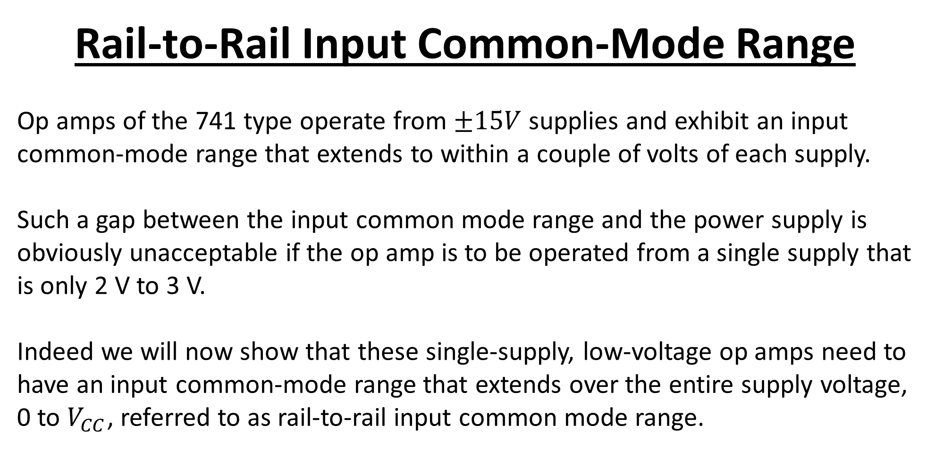
Rail-to-Rail Input Common-Mode Range
Op amps of the 741 type operate from $±15V$supplies and exhibit an input common-mode range that extends to within a couple of volts of each supply.
Such a gap between the input common mode range and the power supply is obviously unacceptable if the op amp is to be operated from a single supply that is only 2 V to 3 V.
Indeed we will now show that these single-supply, low-voltage op amps need to have an input common-mode range that extends over the entire supply voltage, 0 to $V_{CC}$, referred to as rail-to-rail input common mode range.

Slide 92
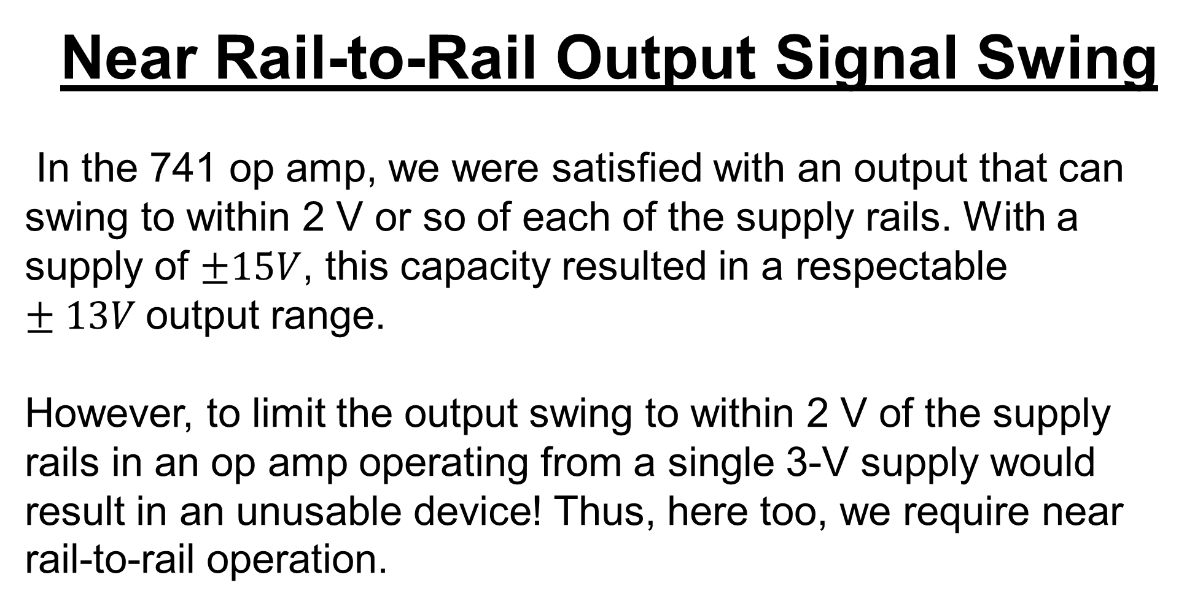
Near Rail-to-Rail Output Signal Swing
In the 741 op amp, we were satisfied with an output that can swing to within 2 V or so of each of the supply rails. With a supply of $±15V$, this capacity resulted in a respectable $±13V$output range.
However, to limit the output swing to within 2 V of the supply rails in an op amp operating from a single 3-V supply would result in an unusable device! Thus, here too, we require near rail-to-rail operation.

Slide 93
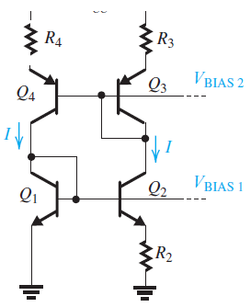
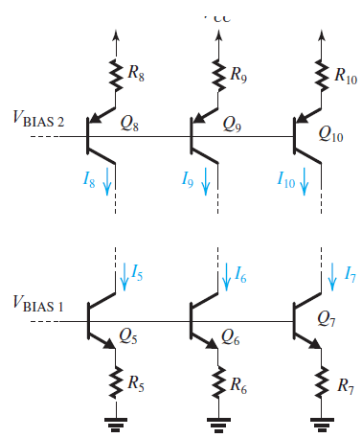
Biasing

Slide 94
Design of the Input Stage to Obtain Rail-to-Rail VICM
For the input common-mode range to include ground voltage, the classical current-mirror-loaded input stage in (a) has to be replaced with the resistively-loaded configuration in (b) with the dc voltage drop across RC limited to 0.2–0.3 V.

Slide 95
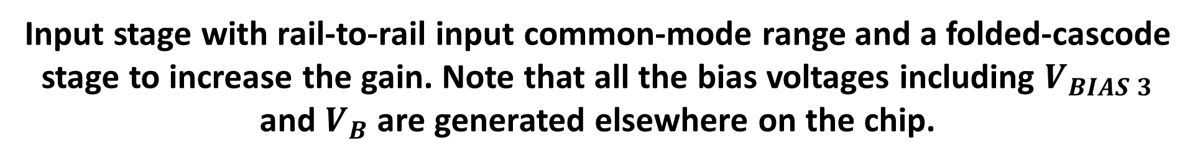
Input stage with rail-to-rail input common-mode range and a folded-cascode stage to increase the gain. Note that all the bias voltages including $V_{BIAS 3}$ and $V_{B}$ are generated elsewhere on the chip.

Slide 96
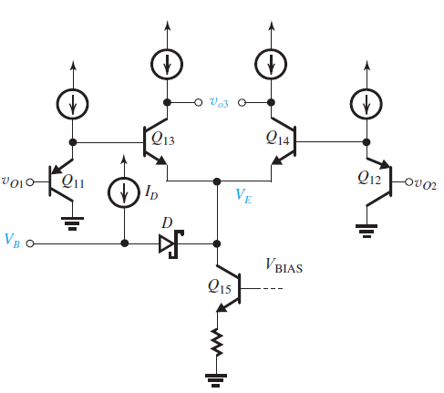
Common-Mode Feedback to Control the dc Voltage at the Output of the Input Stage
An op amp second stage incorporating the common-mode feedback circuit for the input stage. Note that the circuit generates the voltage VB needed to bias the cascode circuit in the first stage. Diode D is a Schottky-barrier diode which exhibits a forward voltage drop of about 0.4V.

Slide 97
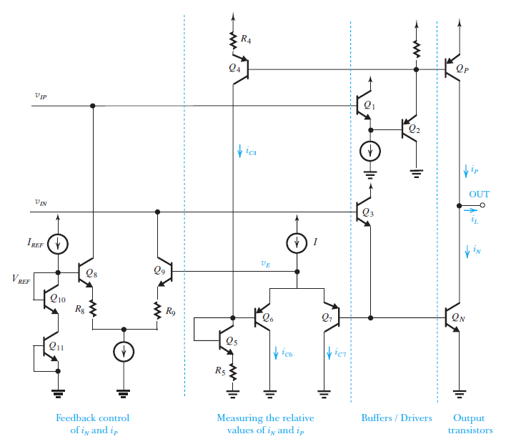
Output Stage
A more complete version of the output stage showing the circuits that establish the quiescent current in QP and QN. As well, this circuit forces a minimum current of (IQ/2) to follow in the inactive output transistor, thus preventing the transistor from turning off and minimizing crossover distortion.

Slide 98
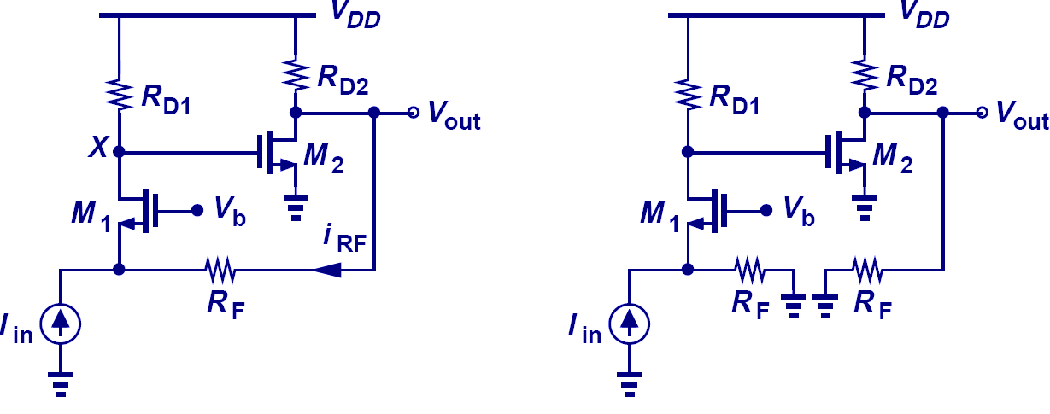
Breaking the Loop Example III

Slide 99
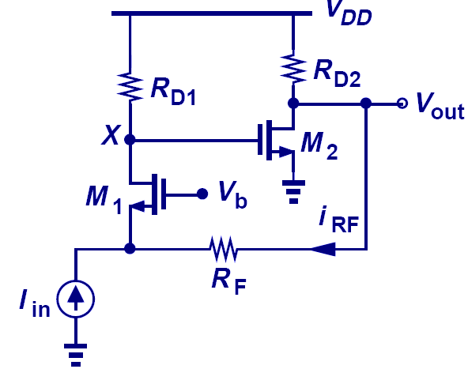
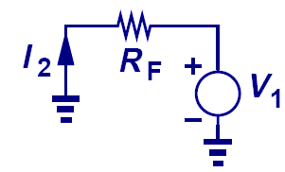
Feedback Factor Example III

Slide 100
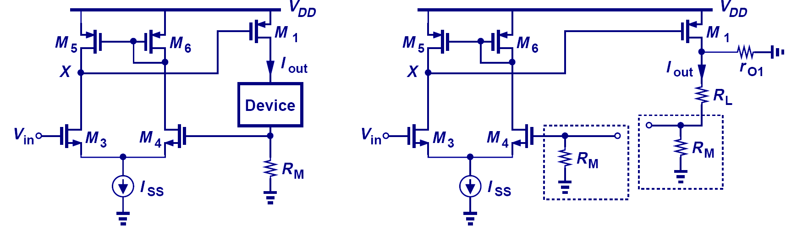
Breaking the Loop Example IV

Slide 101
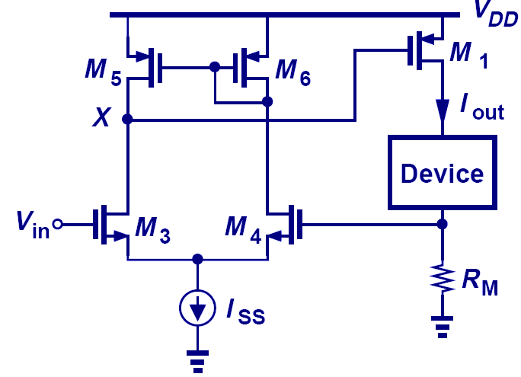

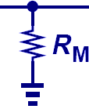
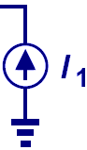
Feedback Factor Example IV

Slide 102
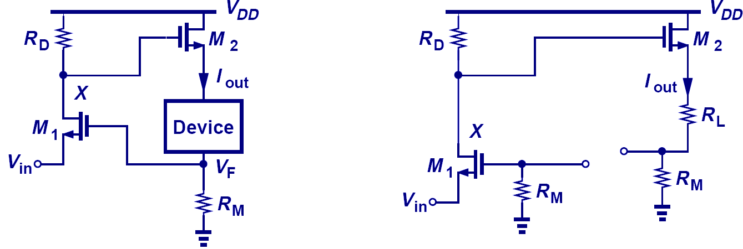
Breaking the Loop Example V

Slide 103
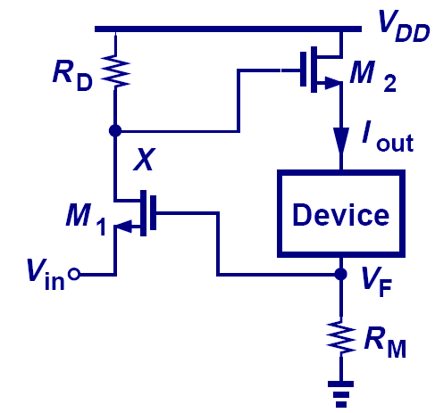
Feedback Factor Example V

Slide 104
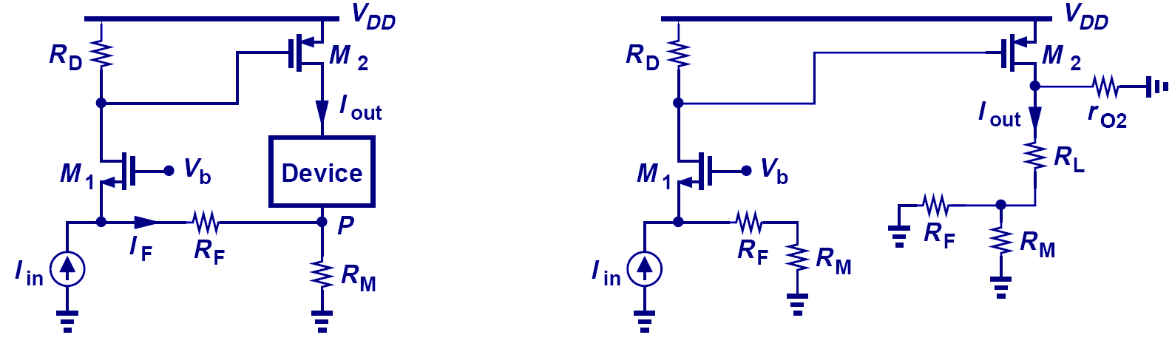
Breaking the Loop Example VI

Slide 105
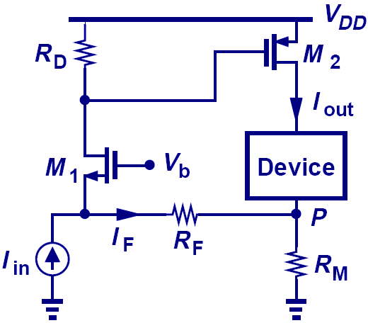
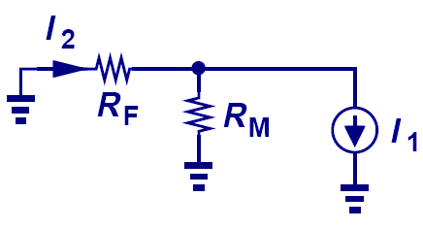
Feedback Factor Example VI

Slide 106
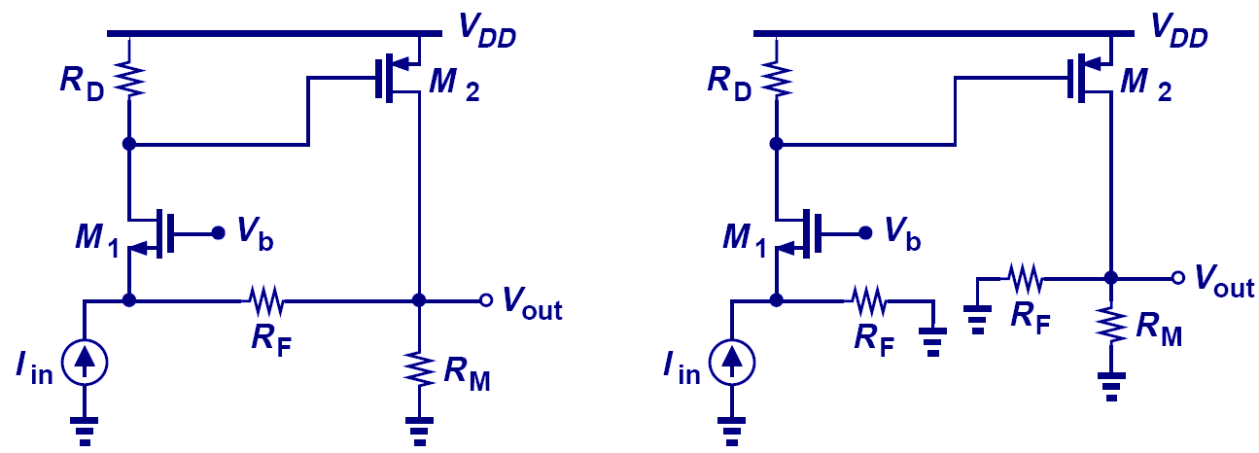
Breaking the Loop Example VII

Slide 107

Feedback Factor Example VII

